Slide 1


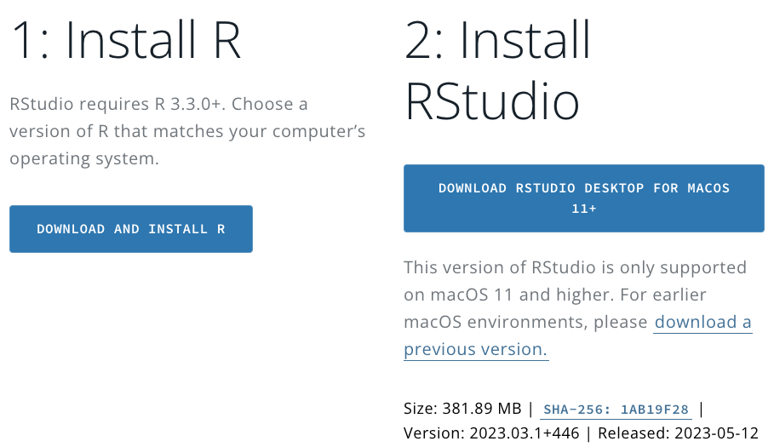
Getting set up with R Studio
(if you haven’t already)
Posit, formerly Rstudio:
https://posit.co/download/rstudio-desktop/
Download/Install R
Download/Install R Studio (website should detect your OS)
That’s it

Slide 2
Basic R
‘data_name’ <- data: Create an object called ‘data_name’ from the ’data’ object
library vs package: install packages once (install.packages(“”); ‘call’ them using library(package)every time
Data types: character, factor, numeric (double, integer)
Working Directory: use to specify location of files
Data Structures: vectors, matrices, data.frames (tibbles)

Slide 3
Tips to start out with R
Add comments to your code if using script
Use a # at the beginning of the line or at the end of the line
You can also add sections to your script code
At the end of a section add 4 dashes - or 4 hashes #
Avoid dots and spaces in variable names
instead used capital letters or underscore
Check Cheatsheets, especially when using a new package
Top menu Help > Cheatsheets or https://rstudio.com/resources/cheatsheets/
If you are unsure of what something does, type into the console a question mark followed by the function or package
>?function
for common functions, check the introverse package documentation
General introduction to R as a programming language: A Succinct Intro to R
Always load packages at the start of a script
Make sure everything is spelled correctly! and capitalization is consistent when loading in data
Practice makes perfect. Build familiarity with the system and don’t be afraid to make mistakes
When in doubt, Google it!!

Slide 4
Some vocabulary
Function = how you get stuff done in R (chapters in metaphor)
Argument = specifications of functions (specific pages in metaphor)
Packages = are a collection of R functions, complied code and sample data. By default a set of packages are installed during installation. They are stored under a directory called "library" in the R environment (books in metaphor)
Documentation = the explanations of functions and arguments for different packages written by the authors (glossary in metaphor)
“run” or “running code” = enter command into the R console to make it happen
Script = a text file containing (almost) the same commands that you would enter on the command line of R
Data frame = a special type of list where every element of the list has same length (i.e. data frame is a “rectangular” list); de facto data structure for most tabular data and what we use for statistics.
Tibble = tidyverse style dataframe
Indexing = selecting a subset of the elements in order to use them in further analysis or possibly change them. Style depends on syntax (see slide 13 + cheat sheets)

Slide 5
Variable Types in R
character: "a", “swc"
numeric: 2, 15.5
“continuous” variable in other software
integer is similar, use numeric in practice (less limitations)
double is similar, but is a numeric value with decimal places
logical: TRUE, FALSE
complex: 1+4i (complex numbers with real and imaginary parts)
factor: used to describe items that can have a finite number of values (gender, social class, etc.).
A factor has a levels attribute and class "factor"
Optionally, it may also contain a contrasts attribute which controls the parametrization used when the factor is used in a modeling functions.
“categorical” variable in other software. Tell R that a variable is nominal by making it a factor. An ordered factor is used to represent an ordinal variable.

Slide 6
Data Structures in R
Vectors = most common and basic structure in R; a collection of elements that are most commonly of mode character, logical, integer or numeric.
Atomic vector = vector where elements much be the same data type; default vector type
List = a special type of vector. Each element can be a different type.
Matrix = an extension of the numeric or character vectors. They are not a separate type of object but simply an atomic vector with dimensions; the number of rows and columns. As with atomic vectors, the elements of a matrix must be of the same data type.
Array = similar to matrices but can have more than two dimensions
Data frame = a special type of list where every element of the list has same length (i.e. data frame is a “rectangular” list); de facto data structure for most tabular data and what we use for statistics

Slide 7
How to effectively search for help online:
when in doubt, copy and paste an error into google
include the package name or “in R” in your search
built-in R help function ?function
StackOverflow
RStudio Community
Be willing and ready to adapt code to your context
Holly has a lovely document with more details

Slide 8
Data Wrangling

Slide 9


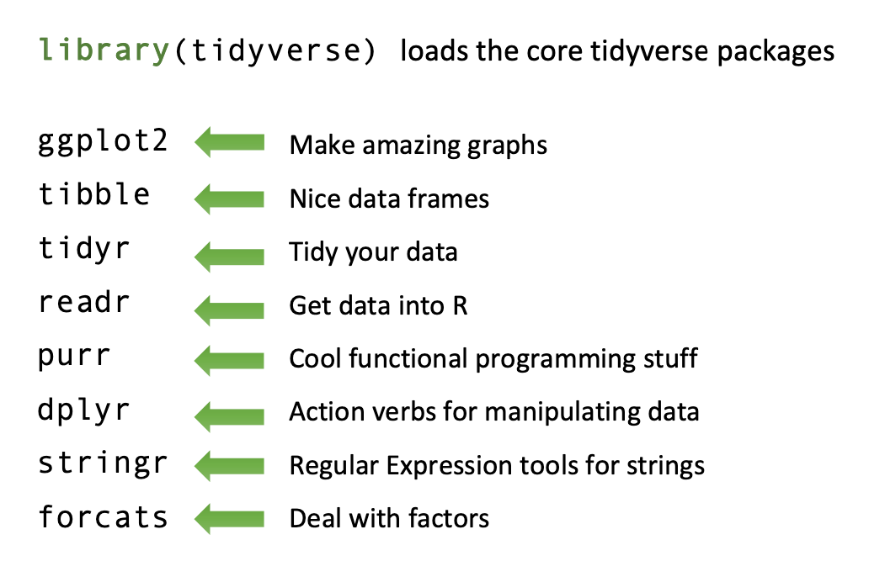
Series of structured packages and tools
Compared to base R, less complex, more user friendly
Offers streamlined data wrangling & visualisation
“Wrangling”: all data-related tidying & manipulating
Tidyverse

Slide 10

The ”Tidy”
”pipe”
Passes previous line of code to next
Keeps code organized, easier to follow
Example:
summary(df) vs df %>% summary

Slide 11





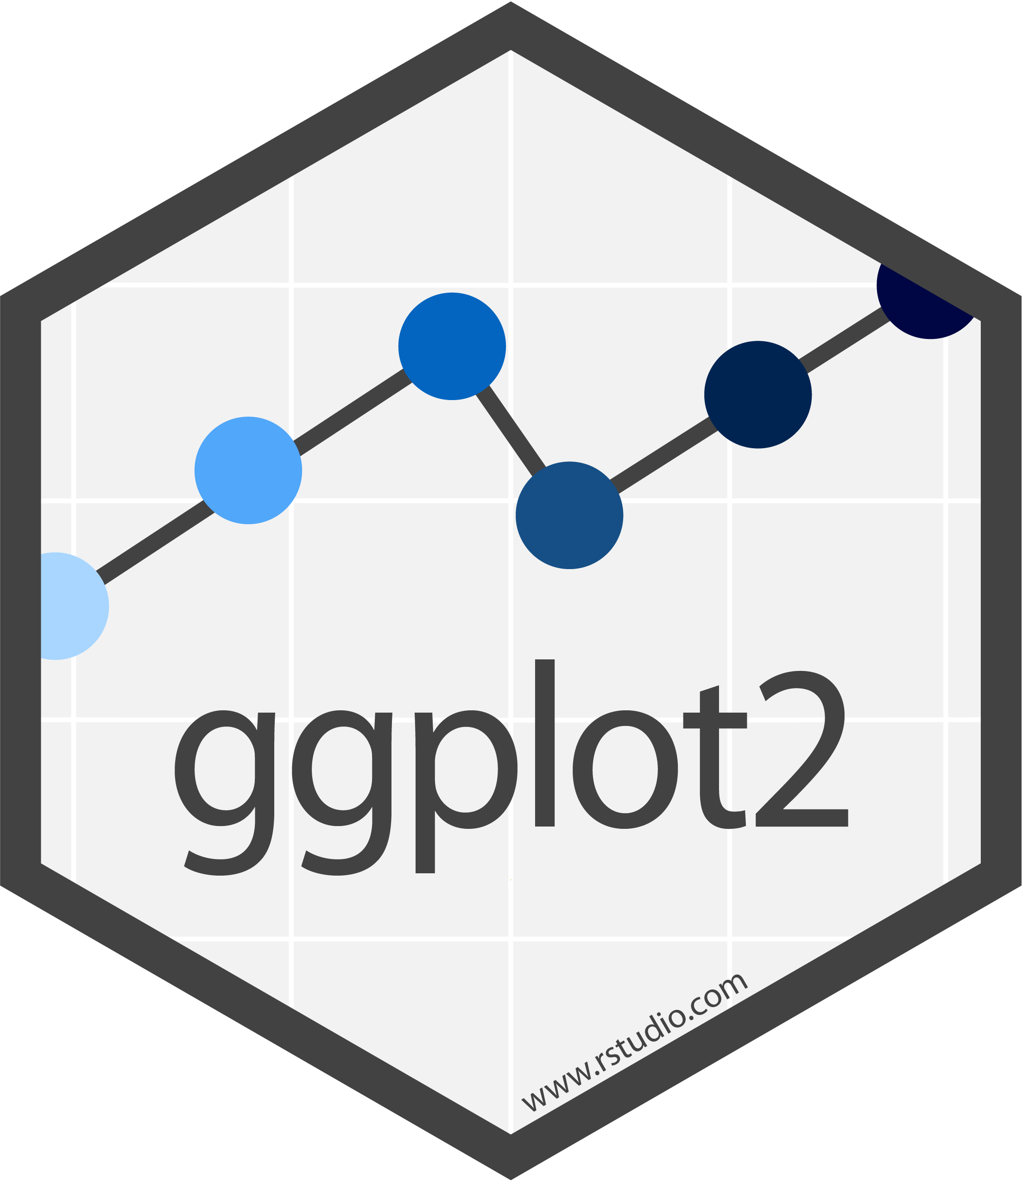










The “Verse”
Notes:
Maybe delete – or just use to comment on the fact that there are maaaaany functions we use in R, and you can be aware of them; several will get touched on. Many load when tidyverse loads.

Slide 12
Plan from Here
Overview of key functions in tidyverse
Demonstration in R using real linguistics data
Move on to plotting
Break at some point

Slide 13

Wrangling: The data “%>%”-line
Artwork by Allison Horst

Slide 14
Import and Prep Data

Slide 15

Importing Data
read_csv()
Can read data in:
From an online link (live data)
From a saved file somewhere on your device with working directory correctly specified – will come back to this
With full file path
You guessed it: Allison Horst
Notes:
Use read_csv , read.csv
Can read data in:
From an online link (live data)
From a saved file somewhere on your device with working directory correctly specified -- will come back to this
Or with full file path

Slide 16

Tidy Data
Keeping data tidy is essential before doing any analysis
Wrangling gets us there
Reasons for untidy data
Column headers contain values, rather than names
Duplicated variables/observations across columns, rows, tables
Wickham, H. (2014). Tidy data. Journal of statistical software, 59(1), 1-23.

Slide 17
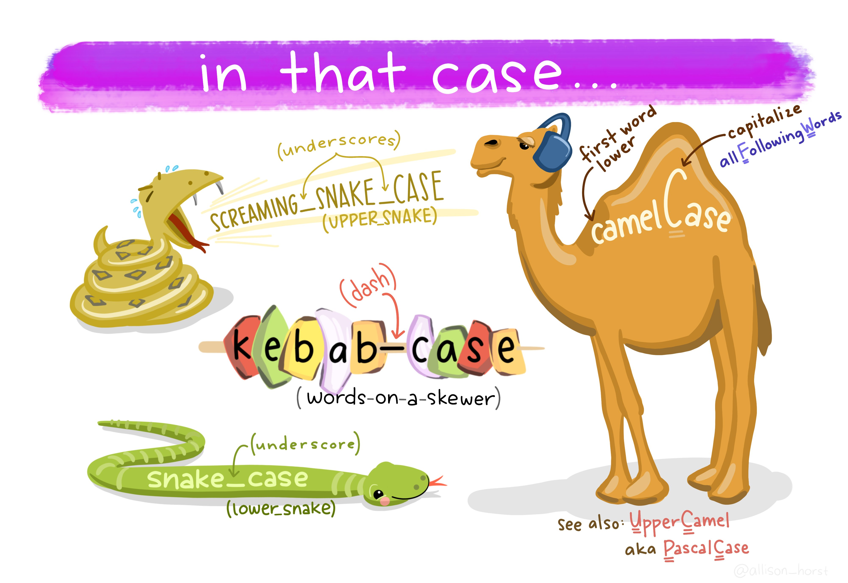
Variable naming conventions
clean_names()
Good practice to have consistent variable naming
This package renames all variables in a data file to have consistent format
Defaults to snake case, but there are 18 options you can choose from
Consistency is key
Artwork by Allison Horst

Slide 18
Subset, Synthesise & Summarise

Slide 19
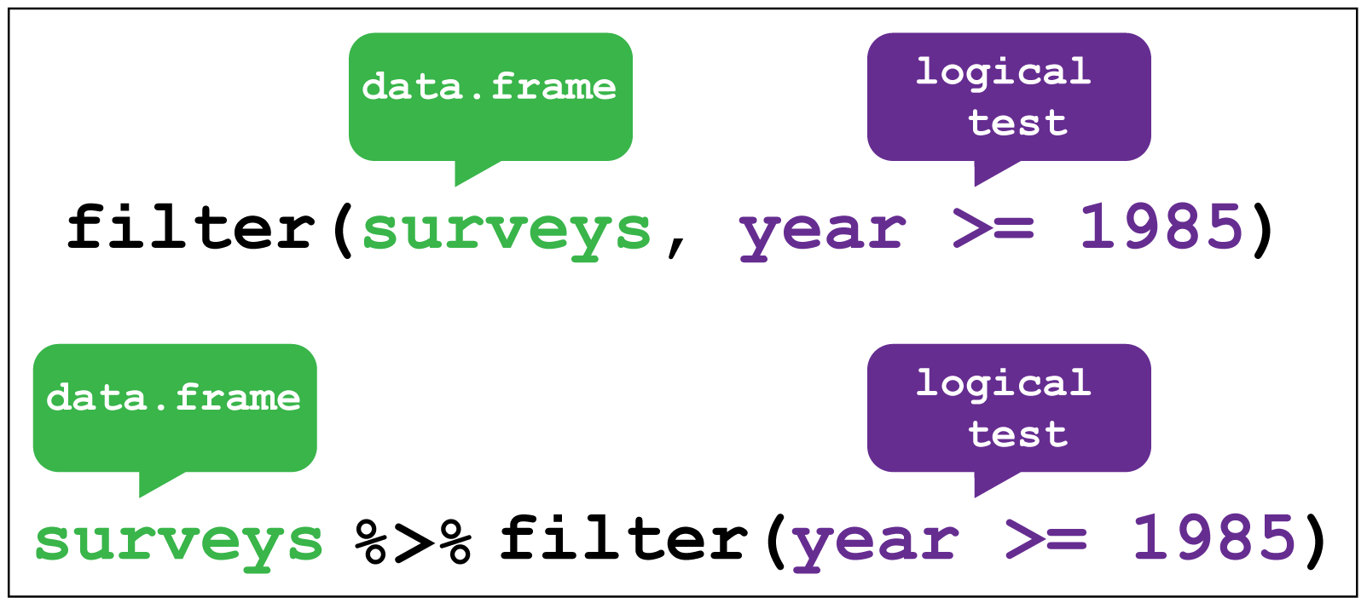
filter()
Subsets observations (rows)
Keeps/removes data that meet specific logical conditions
Requires use of logical operators
Credit: Coding TogetheR

Slide 20
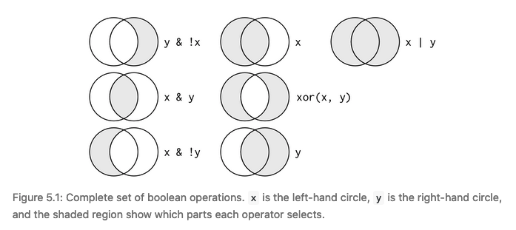
Logical Operators
< | Less than
> | Greater than
== | Equal to
<= | Less than equal to
>= | Greater than equal to
!= | Not equal to
%in% | Group membership [year %in% c(1985, 1995, 2005)]
Source: R for Data Science book, Figure 5.1

Slide 21
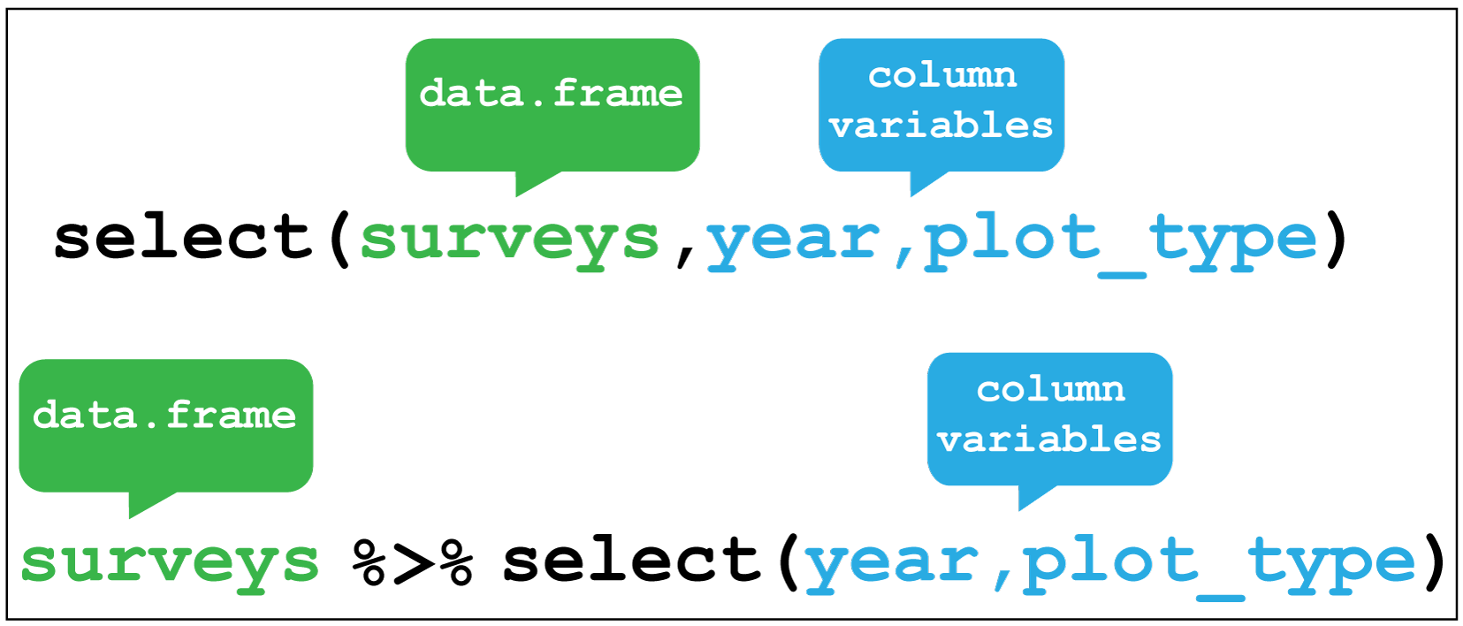
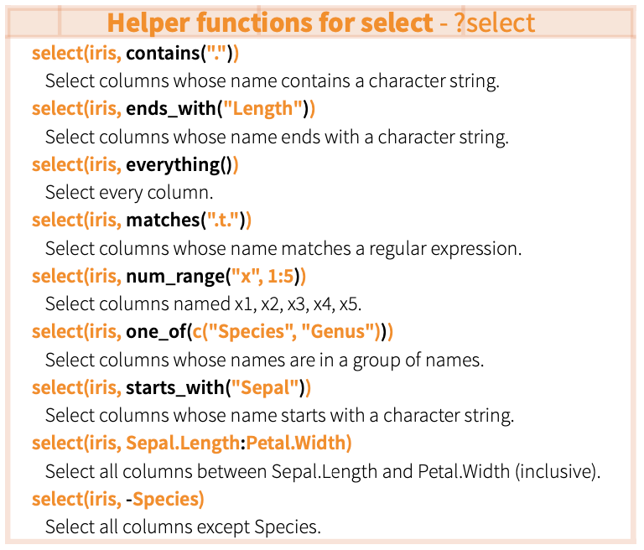
select()
Subset data by variables (columns) using variable name or helper functions
Can also select(-var) to omit variables
Credit: Coding TogetheR

Slide 22
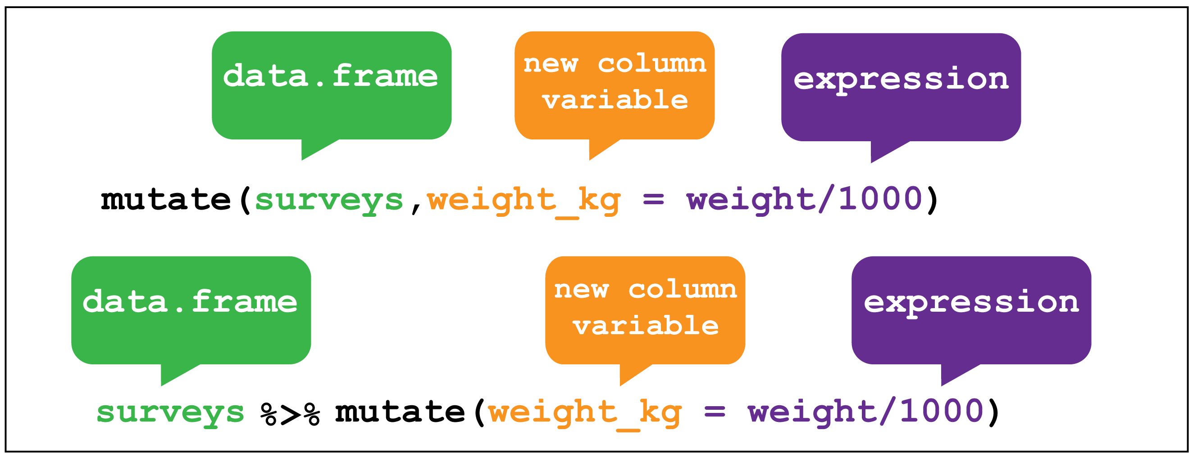
mutate()
Creates new variables
Compute and append one or more new columns – changes an existing column (overwrite some error) or adds a new one
Original columns remain after being passed to mutate unless you overwrite the existing columns
Credit: Coding TogetheR
For more check out this RStudio Data Manipluation video from Garrett Grolemund https://www.youtube.com/watch?v=Zc_ufg4uW4U

Slide 23
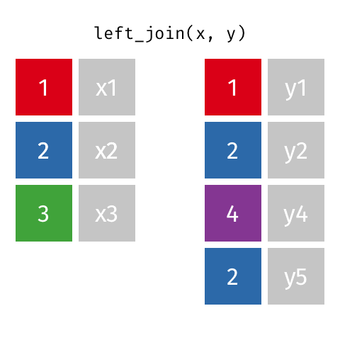
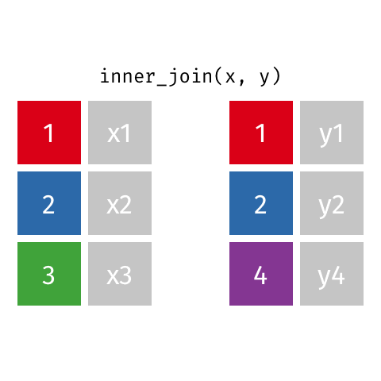
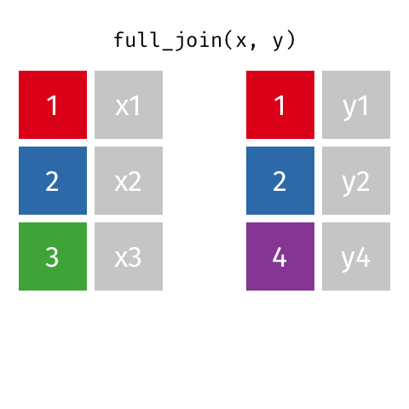
join datasets by columns
left_join()
inner_join()
full_join()
Keeps columns from x
Keeps columns common to x and y
Keeps all columns, merges those in common
Credit: Garrick Aden-Buie: https://www.garrickadenbuie.com/project/tidyexplain/
Notes:
For a fun explanation using The Beatles & Rolling Stones see Nic Crane’s tweet:
https://bit.ly/3qfhBb9

Slide 24
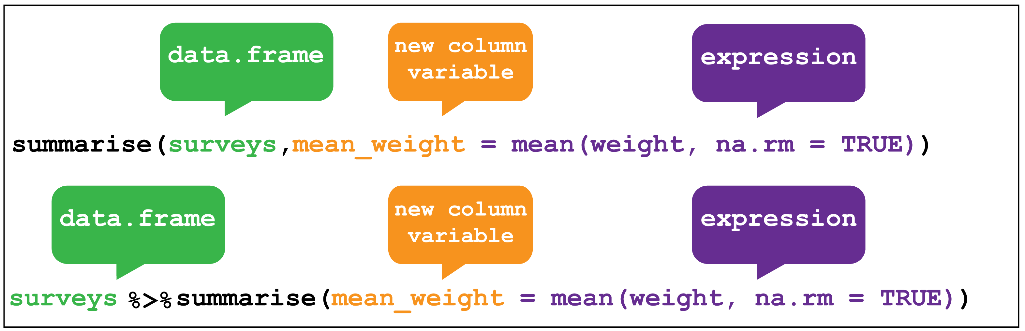
summarise()
Summarise data into single row of values
Mathematical commands: mean, max, min, sd …
Credit: Coding TogetheR

Slide 25
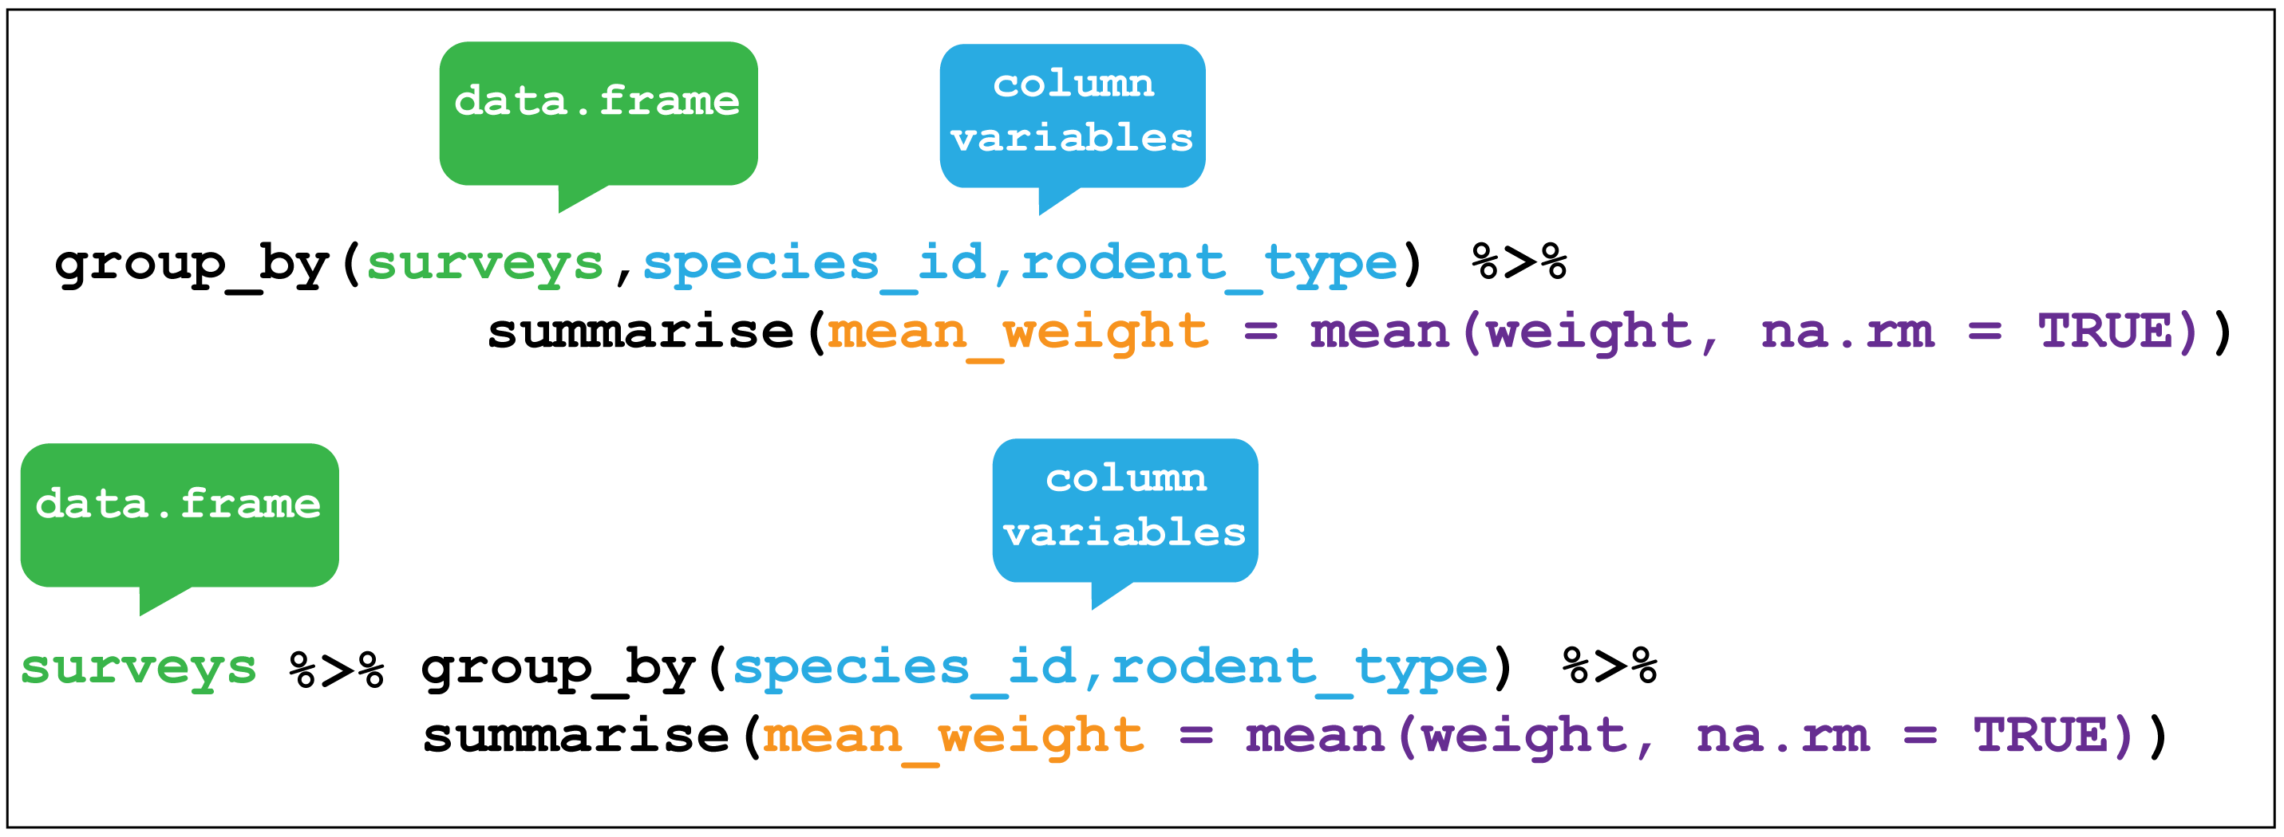
Group Data
group_by()
Group data into rows according to column variables
ungroup()
Remove grouping information from the data frame – particularly useful when wrangling data for tables
Credit: Coding TogetheR
Notes:
summarise() drops variables not listed in group_by() or created inside it, drops columns after calculating the new one

Slide 26
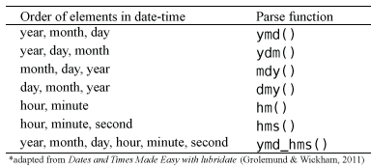
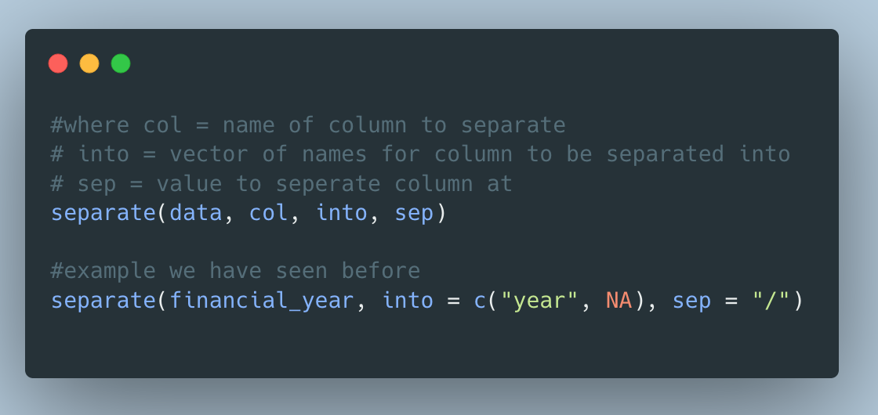

Dates
separate() turns a character column into multiple columns
Notes:
Not much to say – just that lubridate handles dates

Slide 27
Factors & Strings
levels() to see the set of levels in the factor
fct_relevel() to manually reorder factor levels
fct_recode() to manually change the levels labels
fct_collapse() to collapse levels into manually defined groups
str_replace() to change the labels of a string
str_wrap() to wrap the text of a string if it is too long into 2+ lines

Slide 28
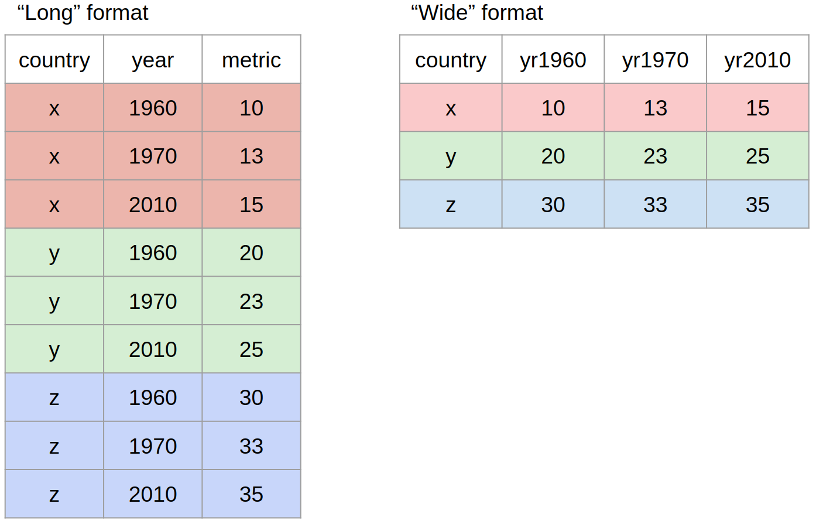
Data formats: wide vs long
Wide Data:
Each row is one observation but may contain multiple levels of same variable in separate columns
Usually not ‘tidy’ (contains redundant info)
Long data:
All rows contain completely unique information
No duplication
”stacked” structure
pivot_wider()
pivot_longer()

Slide 29
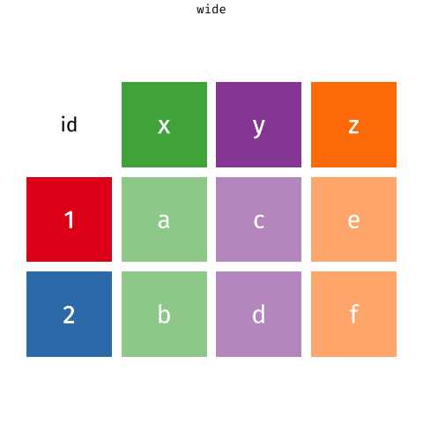
Credit: Garrick Aden-Buie & Mara Averick

Slide 30
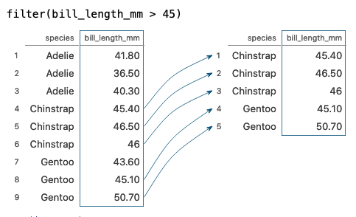
Tidy Data Tutor
Example: Visualisation of the filter() function
https://tidydatatutor.com/

Slide 31

To R studio!
We will be use two datasets drawn from a study of Norwegian words (Hansen, 2017):
norwegian_words_for_analysis.csv
main_data.csv
Researcher was interested in word class, frequency, imageability and phonological neighbourhood density on lexical development
Norwegian Words: http://tekstlab.uio.no/ordforradet/en
Communicative Development Inventories: http://mb-cdi.stanford.edu
Hansen, P. (2017) and Lind et al. (2015)
Data and code available here: https://github.com/samueljhenry8/LELPGC23/tree/main/
Hansen, P. (2017). What makes a word easy to acquire? The effects of word class, frequency, imageability and phonological neighbourhood density on lexical development. First Language, 37(2), 205–225. https://doi.org/10.1177/0142723716679956
Marianne Lind, Hanne Gram Simonsen, Pernille Hansen, Elisabeth Holm & Bjørn-Helge Mevik (2015) Norwegian Words: A lexical database for clinicians and researchers, Clinical Linguistics & Phonetics, 29:4, 276-290, DOI: 10.3109/02699206.2014.999952
Notes:
Read through, then go to R afterward

Slide 32
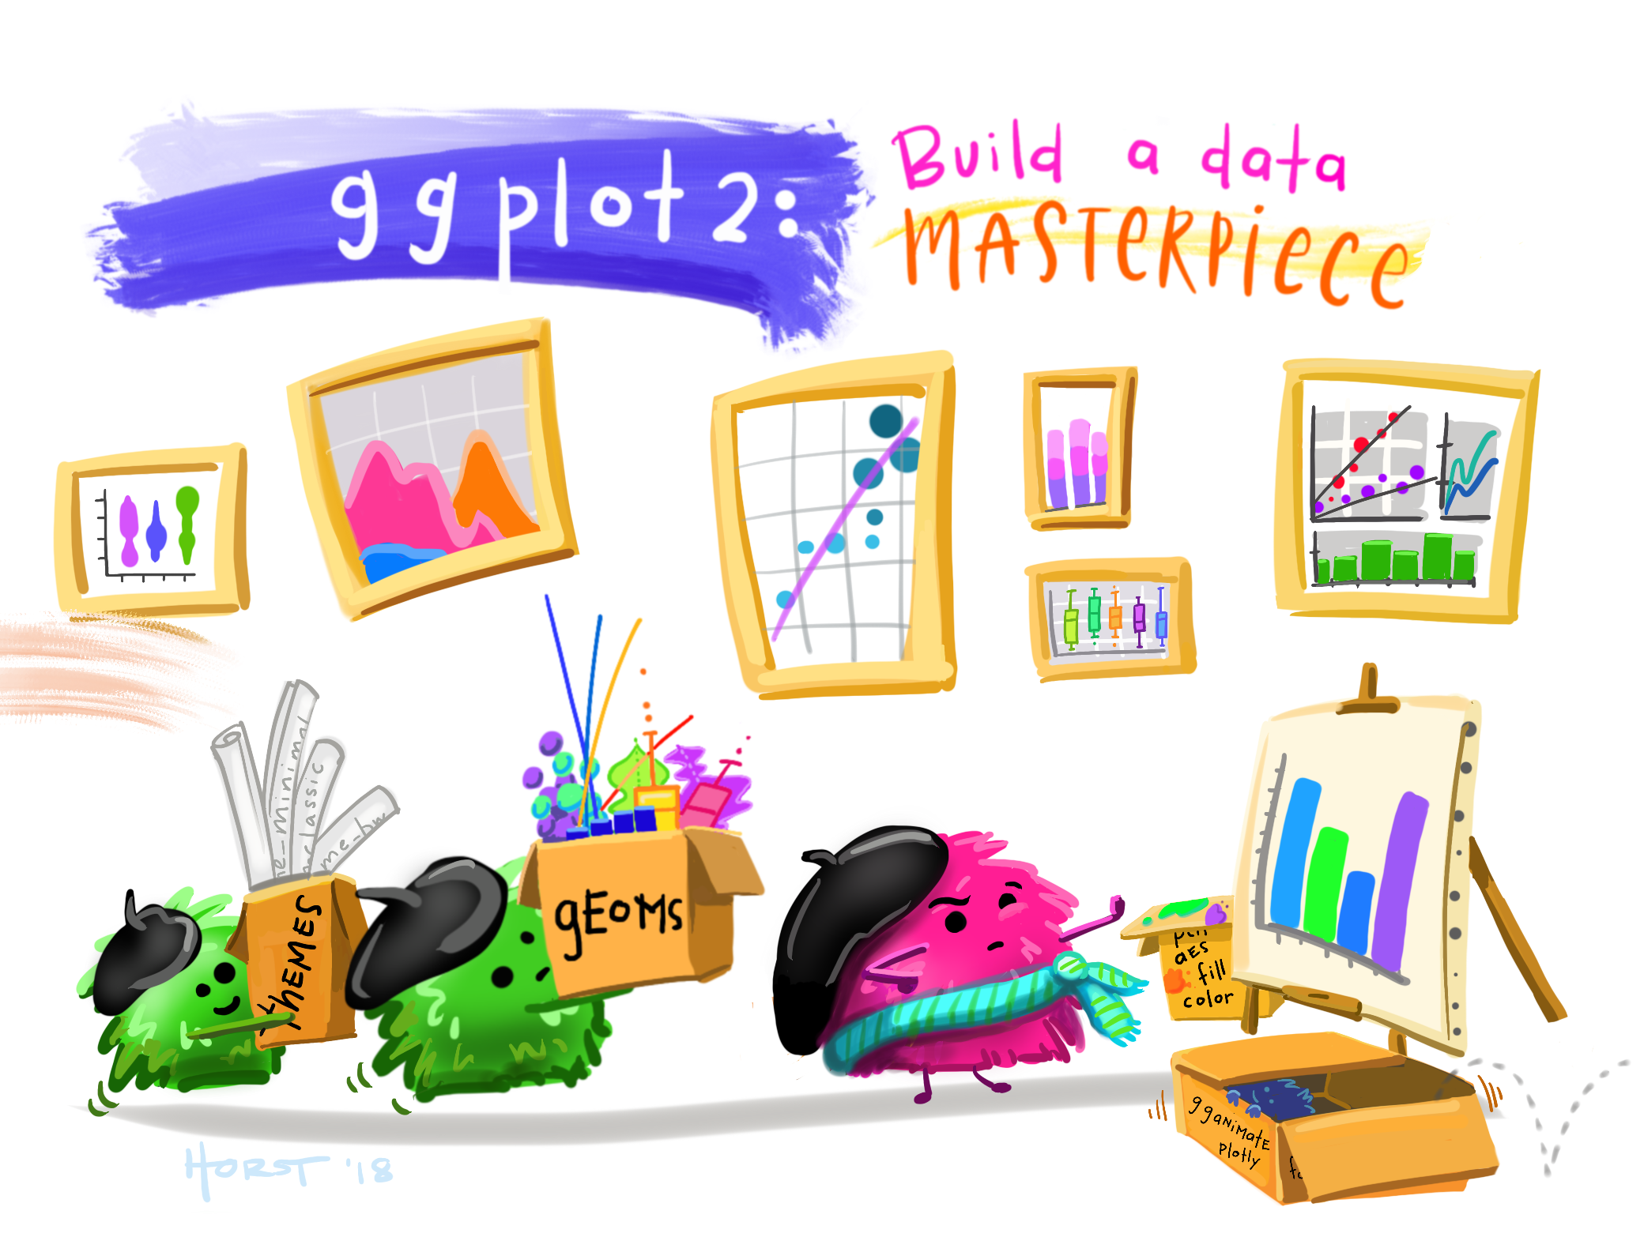
Plotting
Artwork by Allison Horst

Slide 33
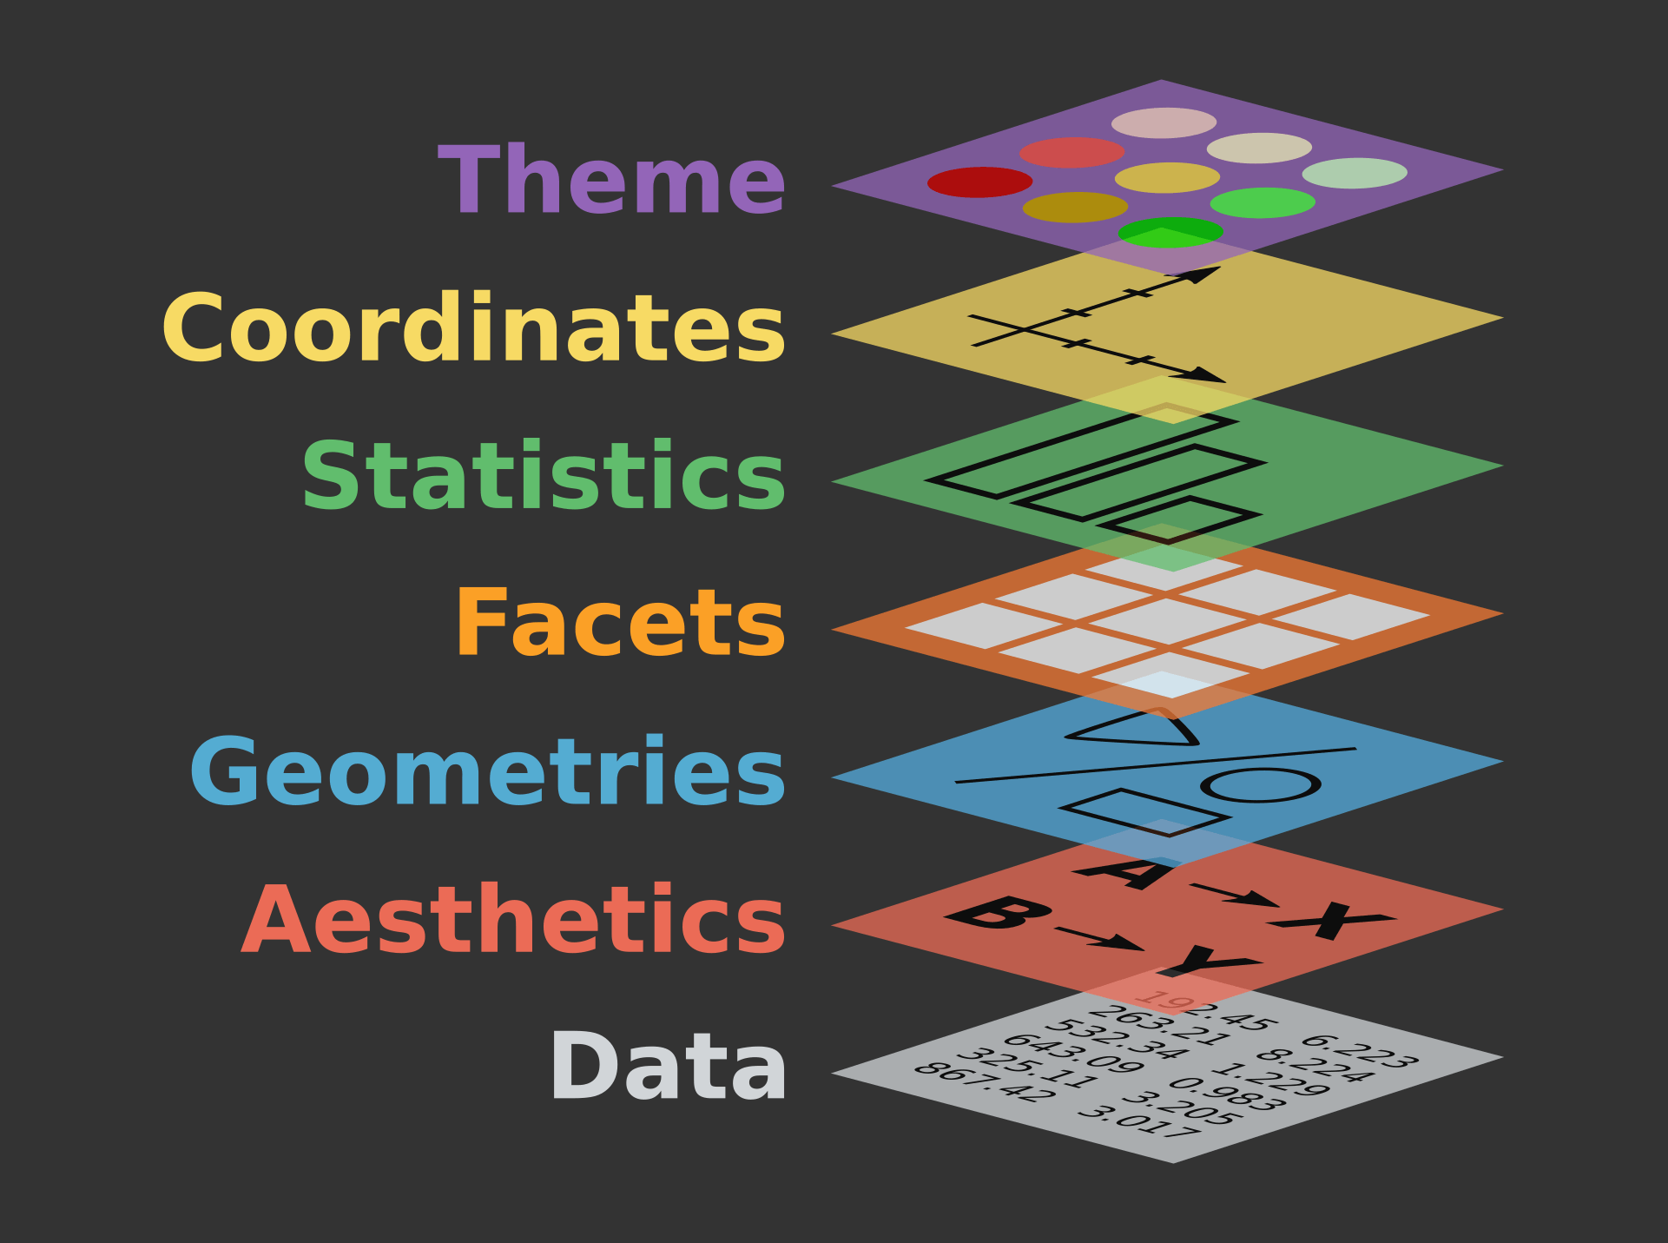
Grammar of Graphics
i.e., ggplot2
+ theme_bw() + theme_classic() etc.
Places layers onto the plotting surface one after another
Order matters (more on this later)
Goes from very basic to quite complex!
+ coord_flip()
Example: + stat_summary()
+ facet_wrap() + facet_grid(x~y)
+ geom_line() + geom_bar() + geom_jitter() etc.
ggplot(data, aes(x, y, color, shape, fill))
ggplot(data)

Slide 34
Building blocks of a ggplot
This layering is reflected in the code itself!
Element | Description | Code
Data | The dataset being plotted | ggplot(data = ,
Aesthetics | The scales onto which we map our data | aes(x, y, fill, color))
Geometries | The visual elements used for our data | + geom_()
Facets | Plotting small multiples | + facet_()
Statistics | Representations of our data to aid understanding | + stat_()
Coordinates | The space on which the data will be plotted | + coord_()
Themes | All non-data ink, design elements | + theme_()
These are the essentials to making a (gg)plot

Slide 35


The key ingredients: data
ggplot(data = cancelled ,
data layer use the data cancelled THEN

Slide 36
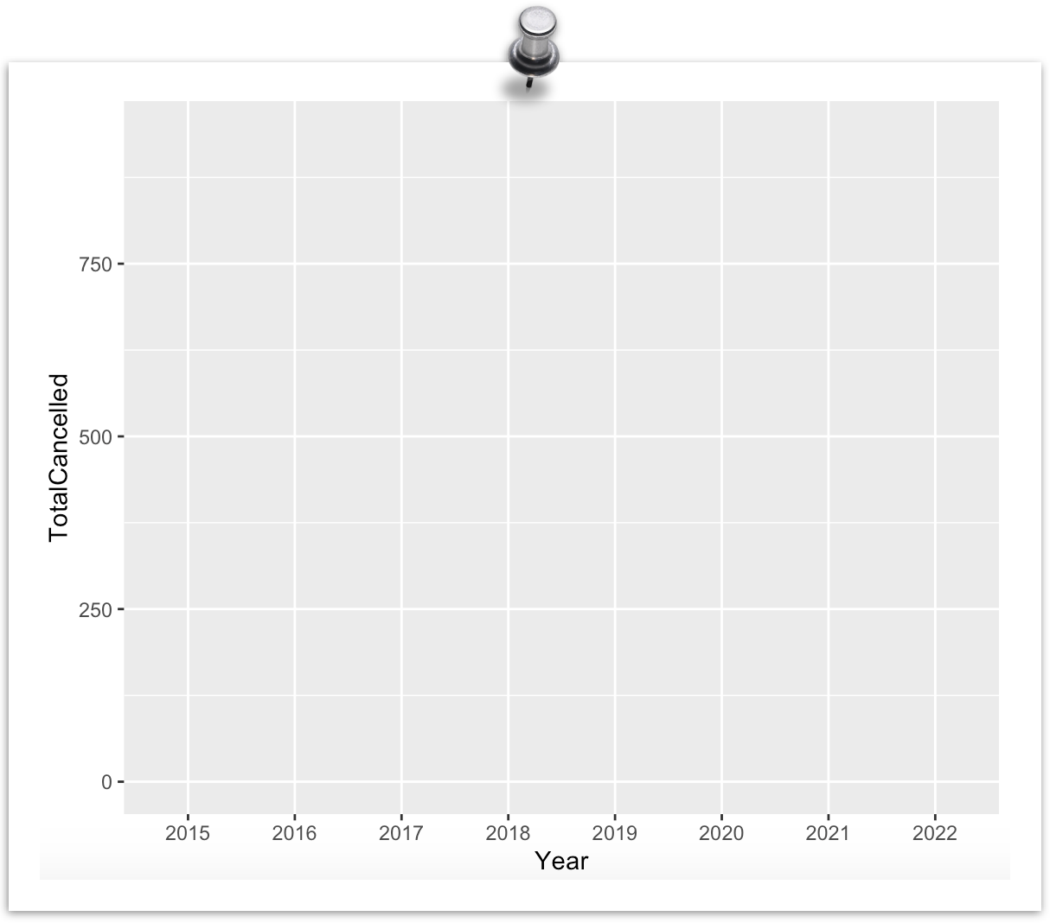

The key ingredients: aes(thetic)
ggplot(data = cancelled ,
data layer use the data cancelled THEN
aes(x = Year, y = TotalCancelled)) +
use the X axis to show “Year” then the Y axis to show ”Total Cancelled” AND
aesthetics layer

Slide 37
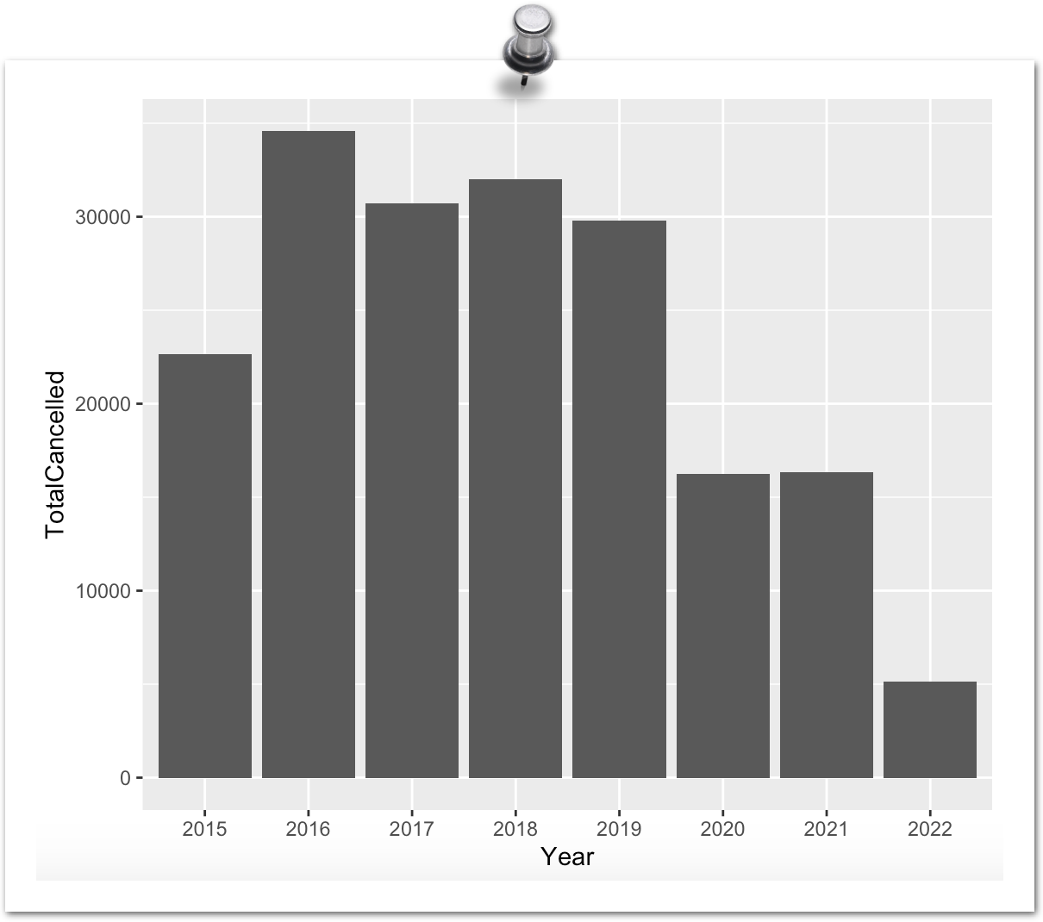
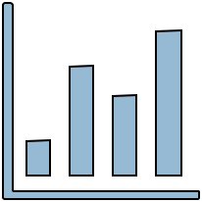
The key ingredients: geom(etry)
ggplot(data = cancelled ,
data layer use the data cancelled THEN
aes(x = Year, y = TotalCancelled)) +
use the X axis to show “Year” then the Y axis to show ”Total Canceled” AND
aesthetics layer
geom_bar()
geometry layer …. take all that and make a bar chart

Slide 38
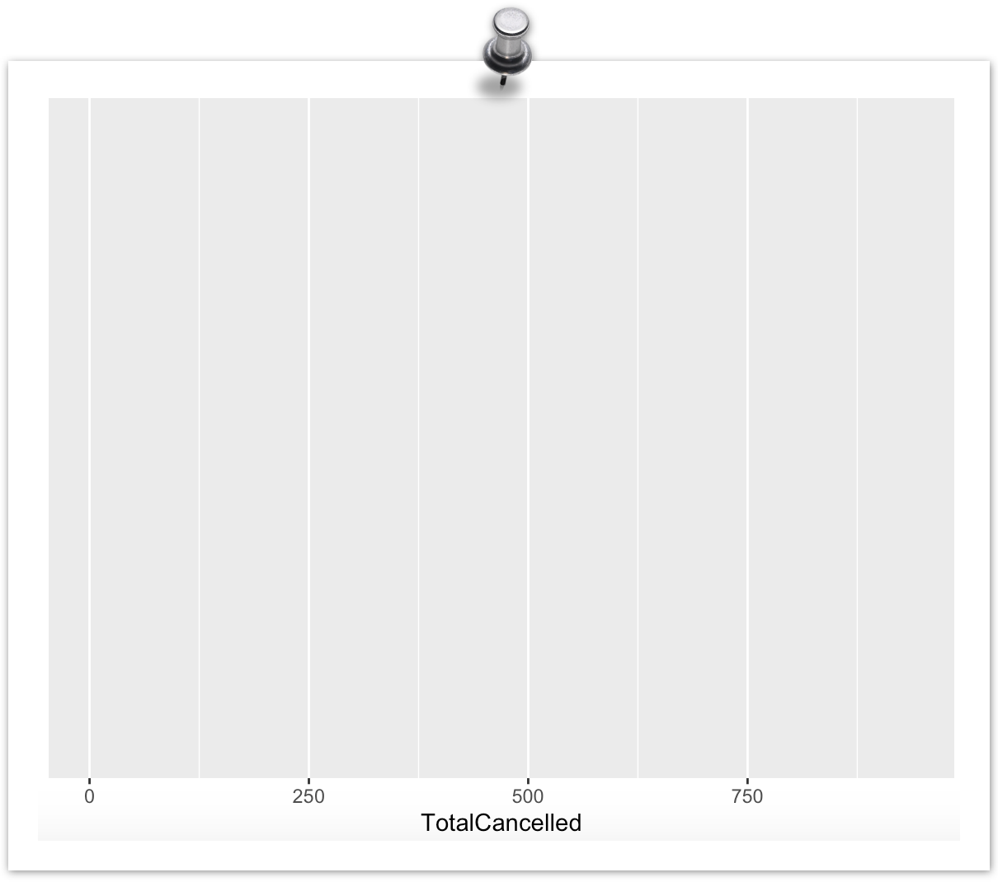
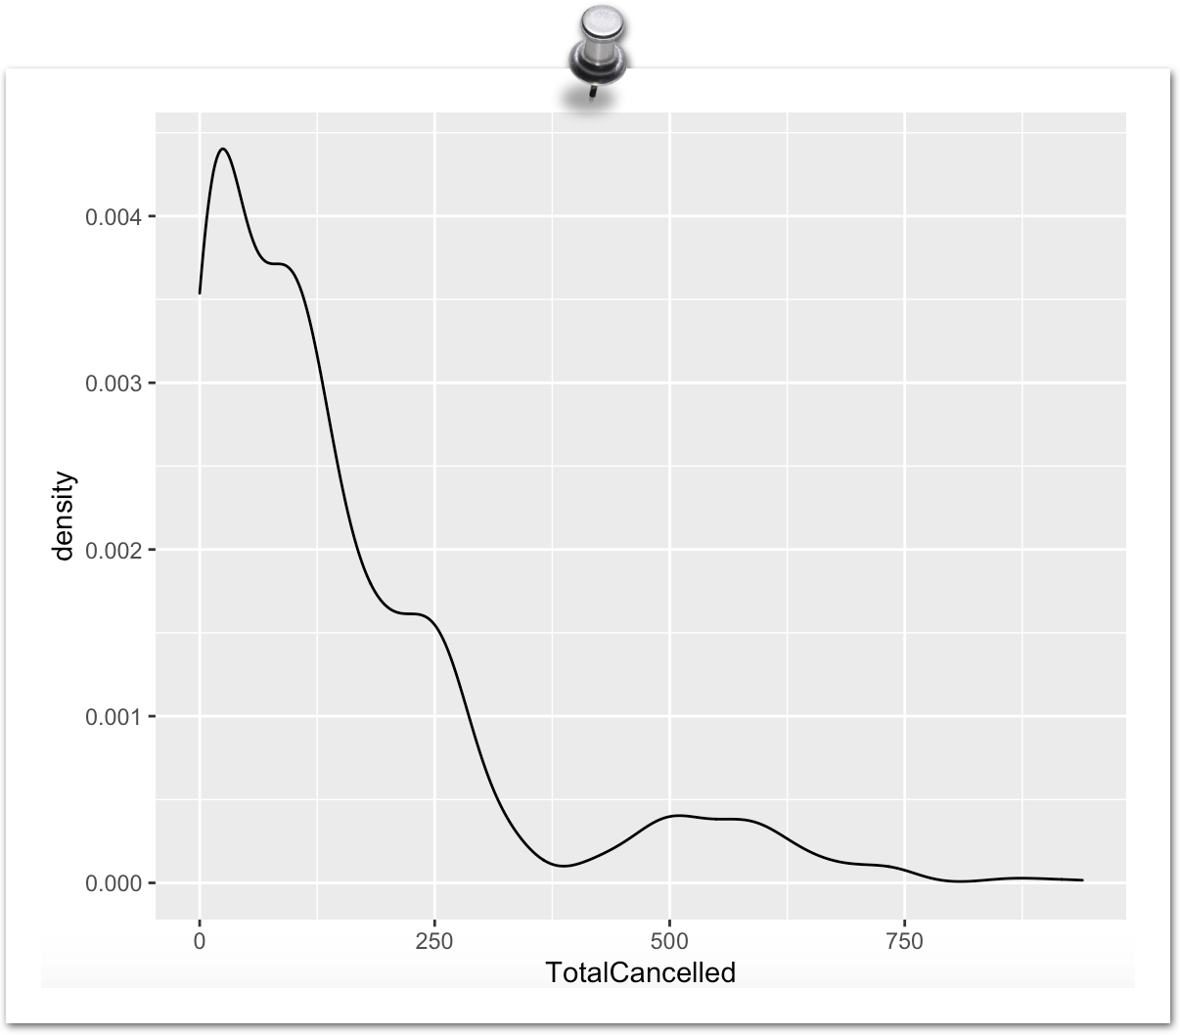
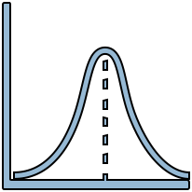
The key ingredients: geom(etry)
ggplot(data = cancelled ,
data layer use the data cancelled THEN
aes(x = TotalCancelled)) +
use the X axis to show ”Total Cancelled” AND
aesthetics layer
geom_density()
geometry layer …. take all that and make a density chart

Slide 39
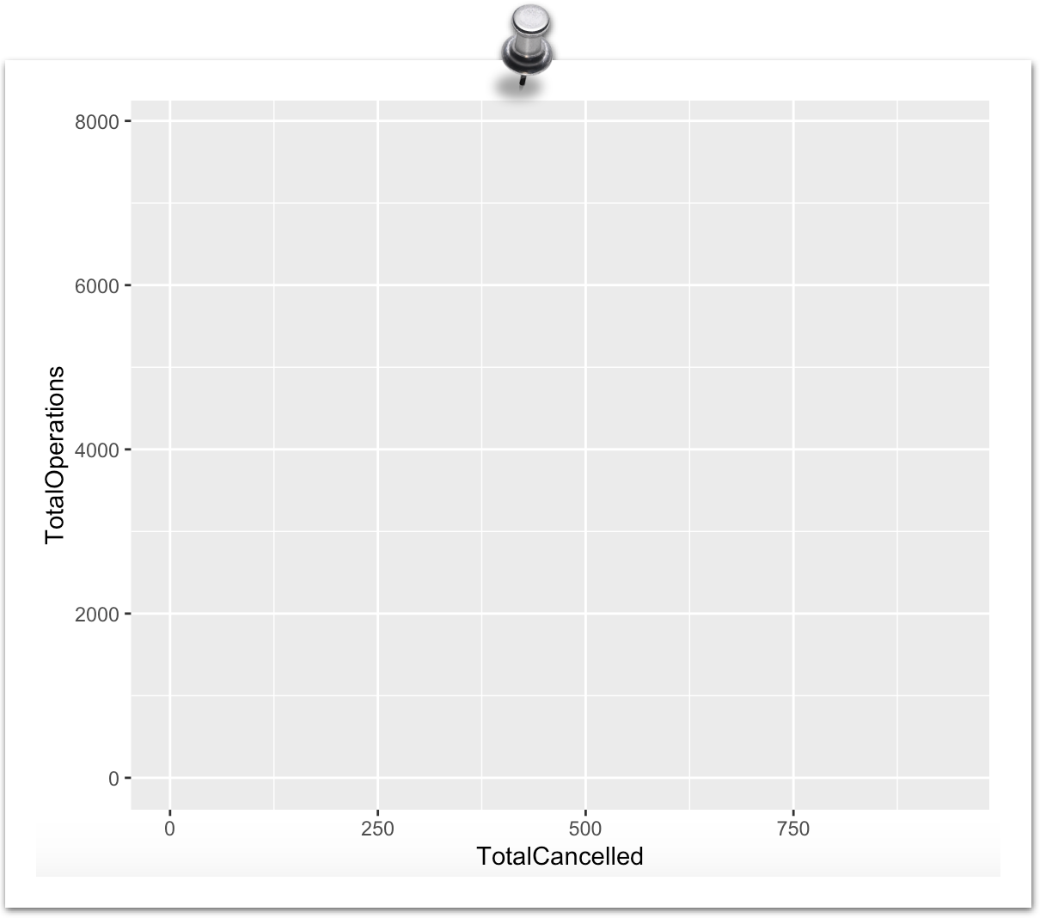
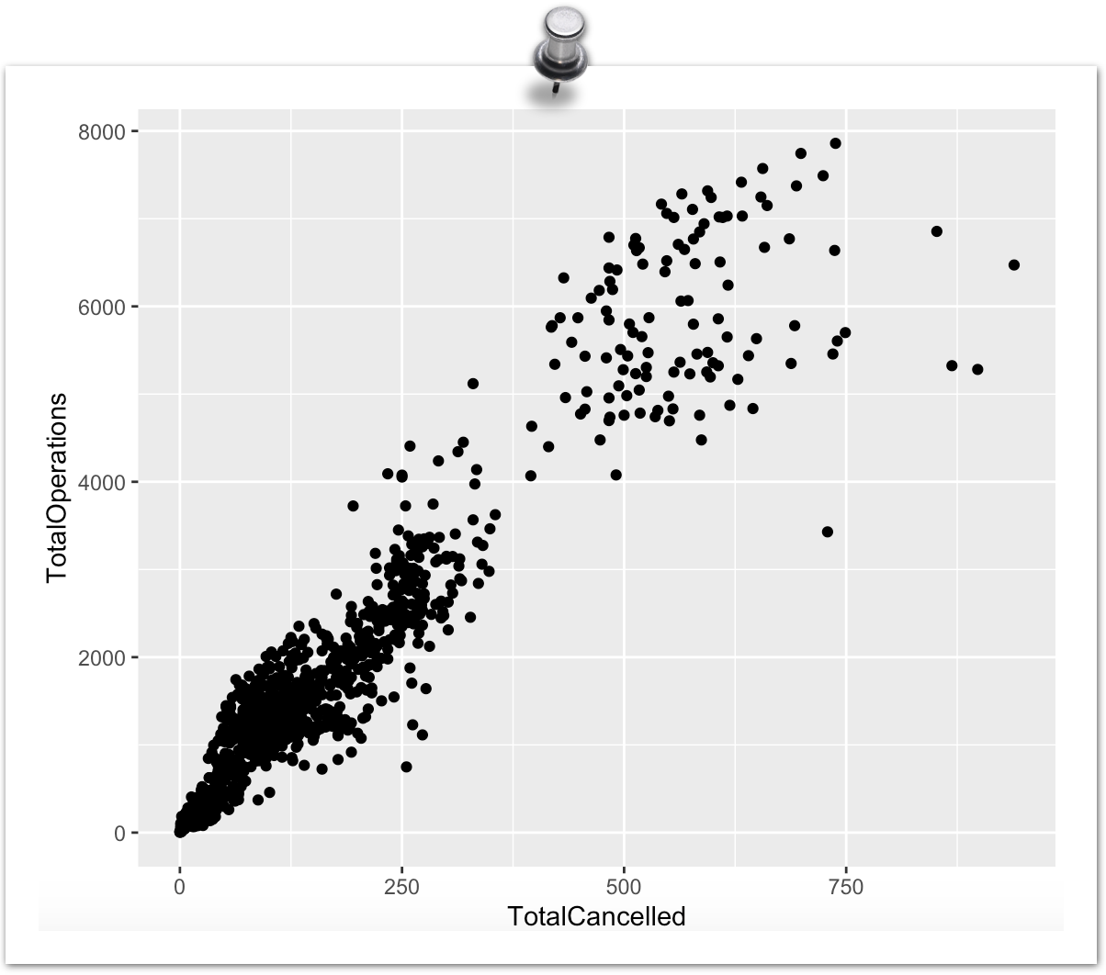
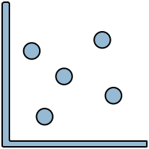
The key ingredients: geom(etry)
ggplot(data = cancelled ,
data layer use the data cancelled THEN
aes(x = TotalCancelled, y = TotalOperations)) +
use the X axis to show “Total Cancelled” then the Y axis to show ”Total Operations” AND
aesthetics layer
geom_point()
geometry layer …. take all that and make a scatter plot
….and so on!

Slide 40
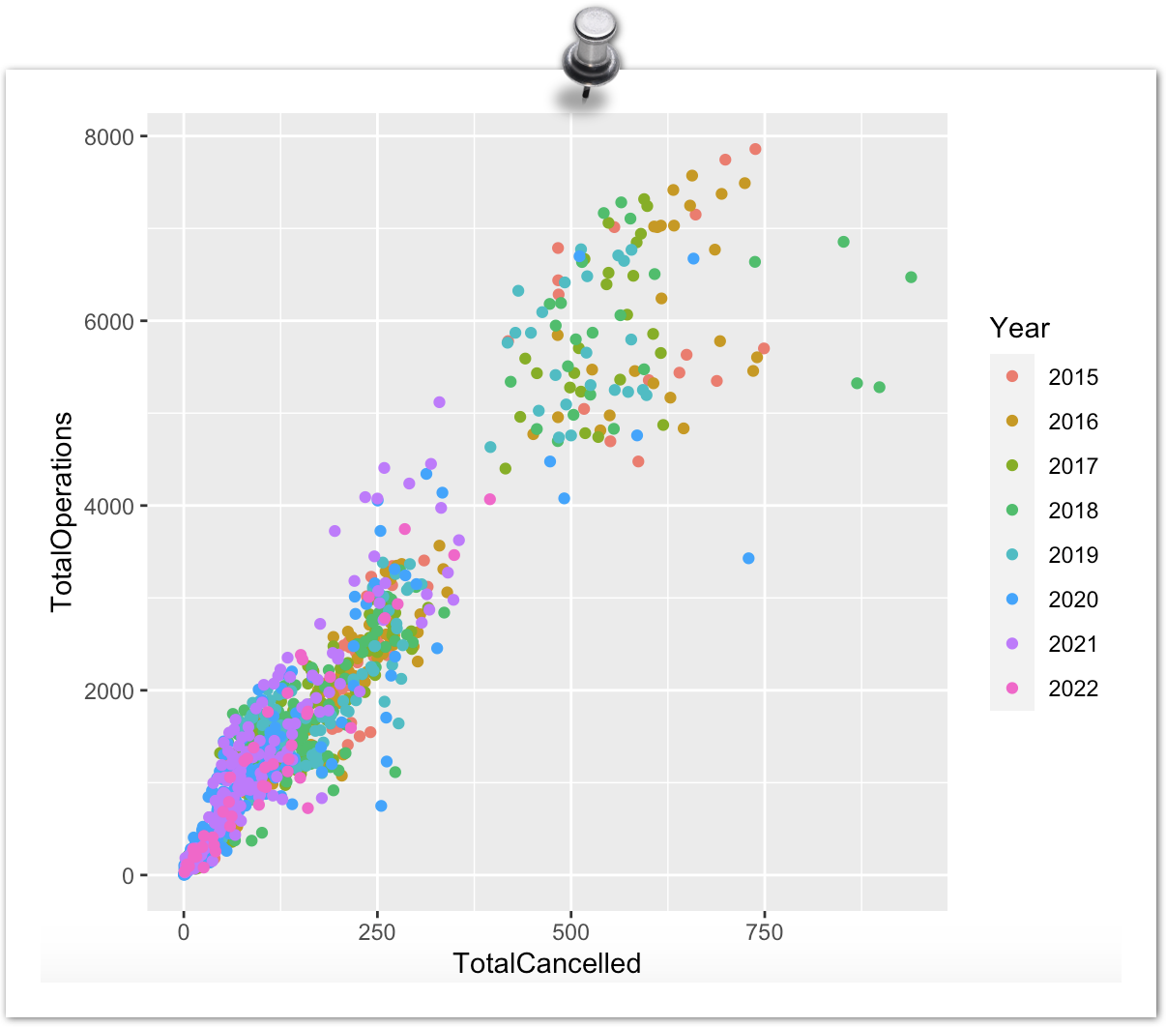
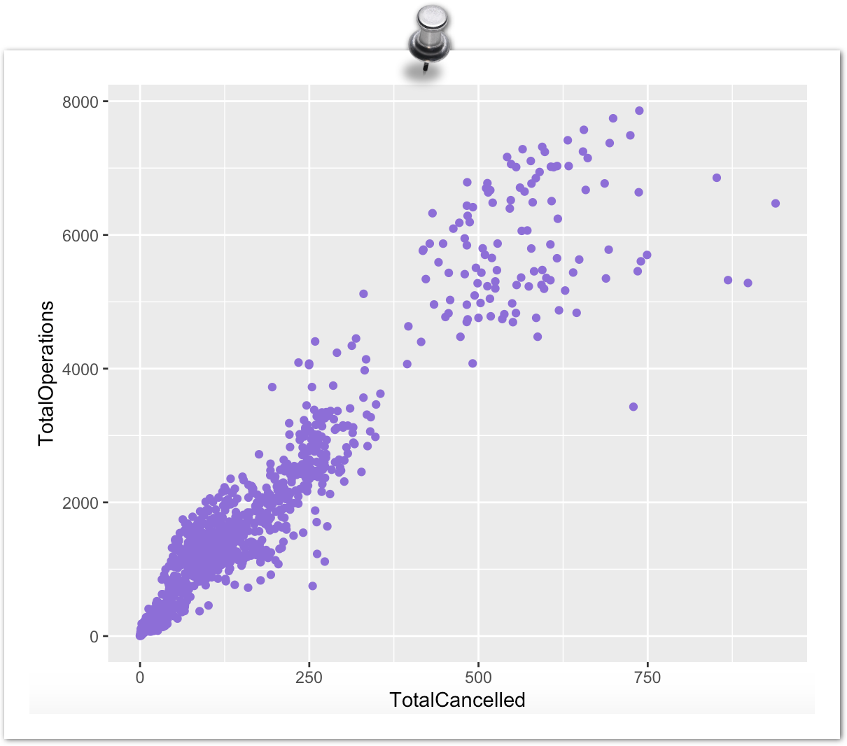
Aesthetics: Inside vs Outside
Within aes(): the argument changes based on the values of the variable
Outside aes(): the argument is given a single value and doesn't change based on the values of the variable

Slide 41
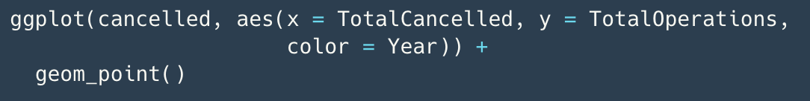
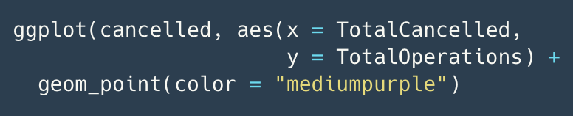



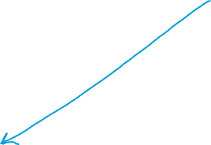

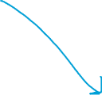
Aesthetics: Inside vs Outside

Slide 42
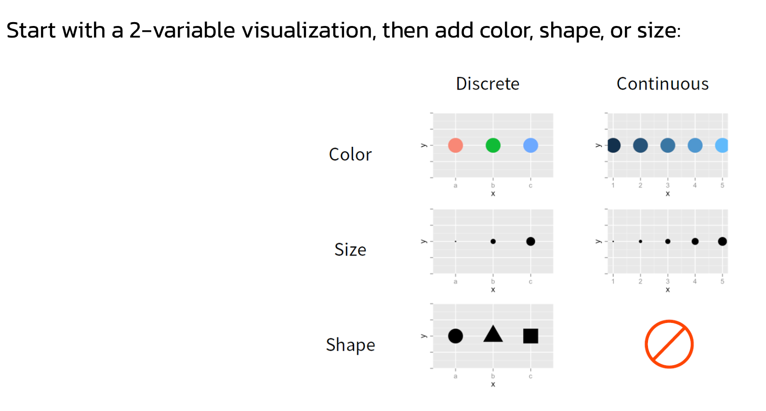
When visualising
3 variables
From Dr Sam Tyner’s guest lecture video in Topic 4

Slide 43
When visualising
3 + variables
Add another variable with Facets

Slide 44
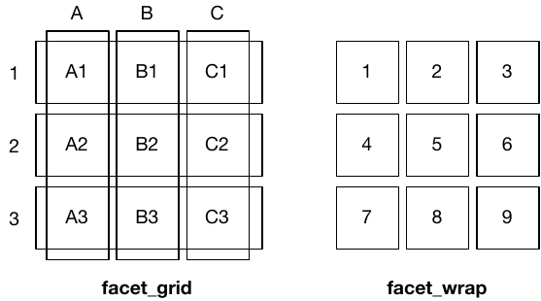
Visualising 3+ variables: Facets
Fundamentally 1 dimensional
Fundamentally 2 dimensional
+facet_grid(row ~ column)
Makes a matrix of panels by row & column faceting variables
+facet_wrap(variable)
Makes a long ribbon of panels

Slide 45
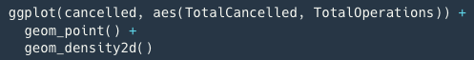
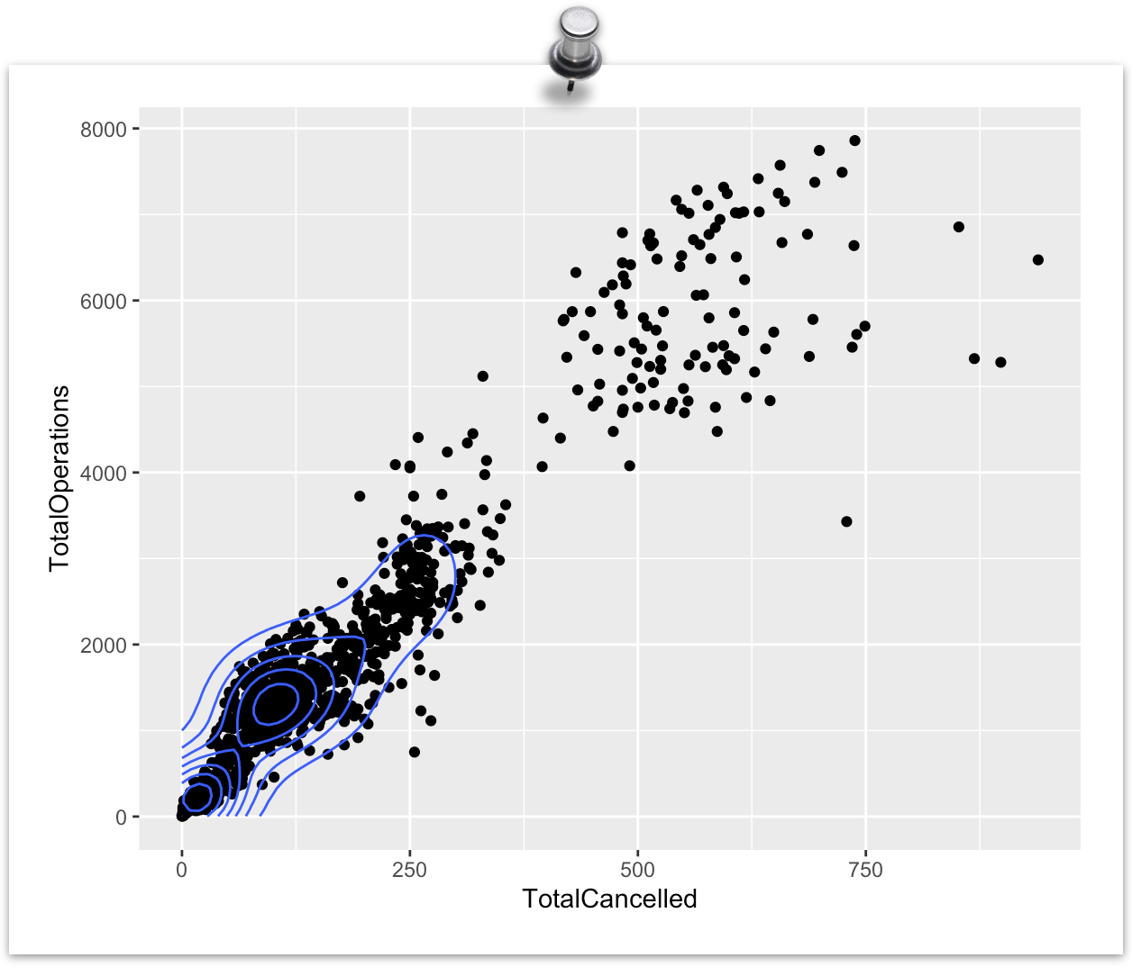
ggplot2 layers
Stacked in order of code appearance
Important to keep in mind as elements written later in your code may hide or overwrite previous elements

Slide 46
Cheatsheets & further resources

Slide 47
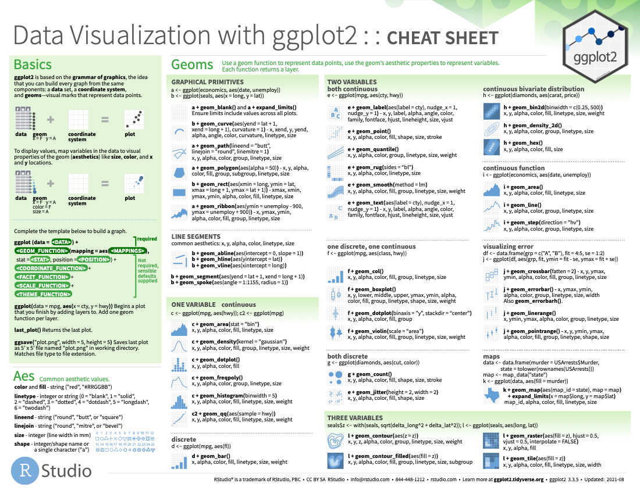
ggplot2
Cheatsheet

Slide 48
Color palettes
Emil Hvitfeldt has created a “one stop destination for anyone looking for a color palette to use in r.” https://github.com/EmilHvitfeldt/r-color-palettes
Including an interactive color selector! https://emilhvitfeldt.github.io/r-color-palettes/discrete.html

Slide 49
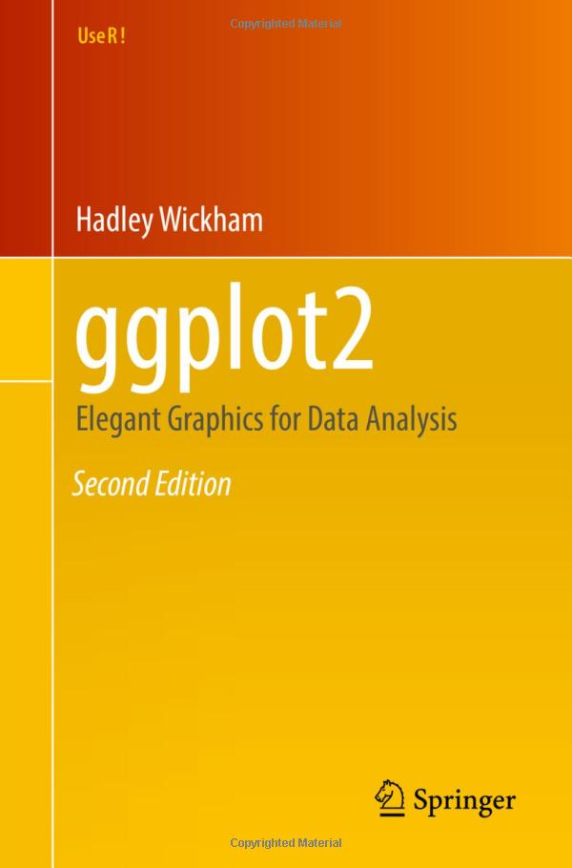
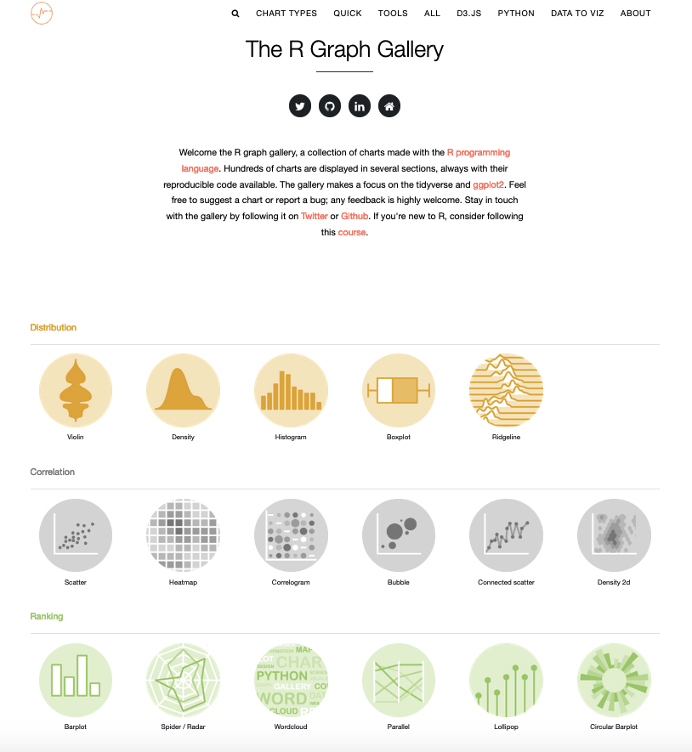
Further Resources
(free!) ggplot2 book
R Graph Gallery
Excellent 2-part workshop on Youtube by Thomas Lin Pedersen: covers all this and more!
Part 1: https://www.youtube.com/watch?v=h29g21z0a68
Part 2: https://www.youtube.com/watch?v=0m4yywqNPVY
*NB, 4.5 hours long

Slide 50
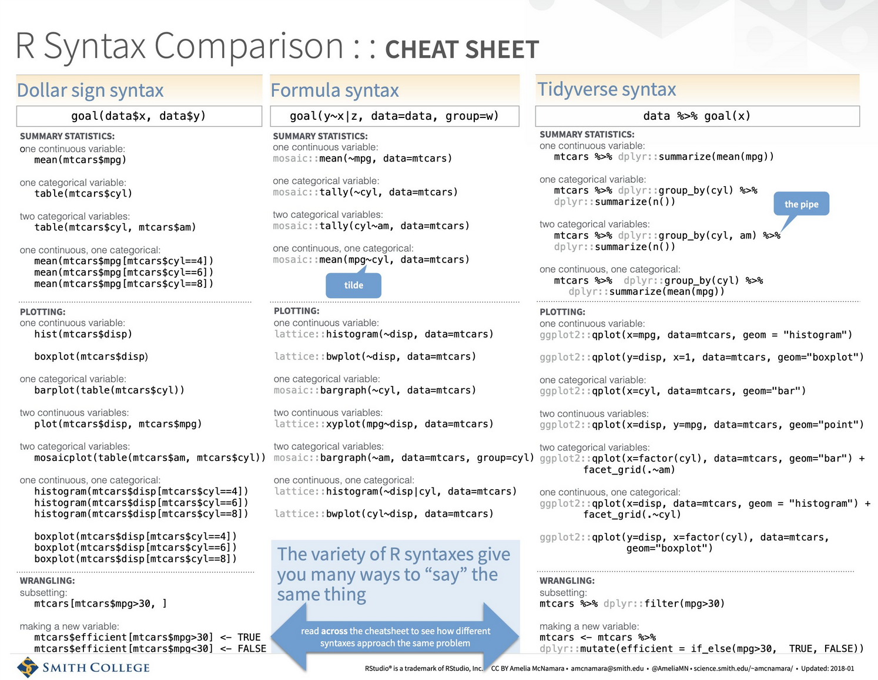
last updated 2018, needs some updating
credit to Amelia McNamara
Notes:
https://www.amelia.mn/Syntax-cheatsheet.pdf

Slide 51
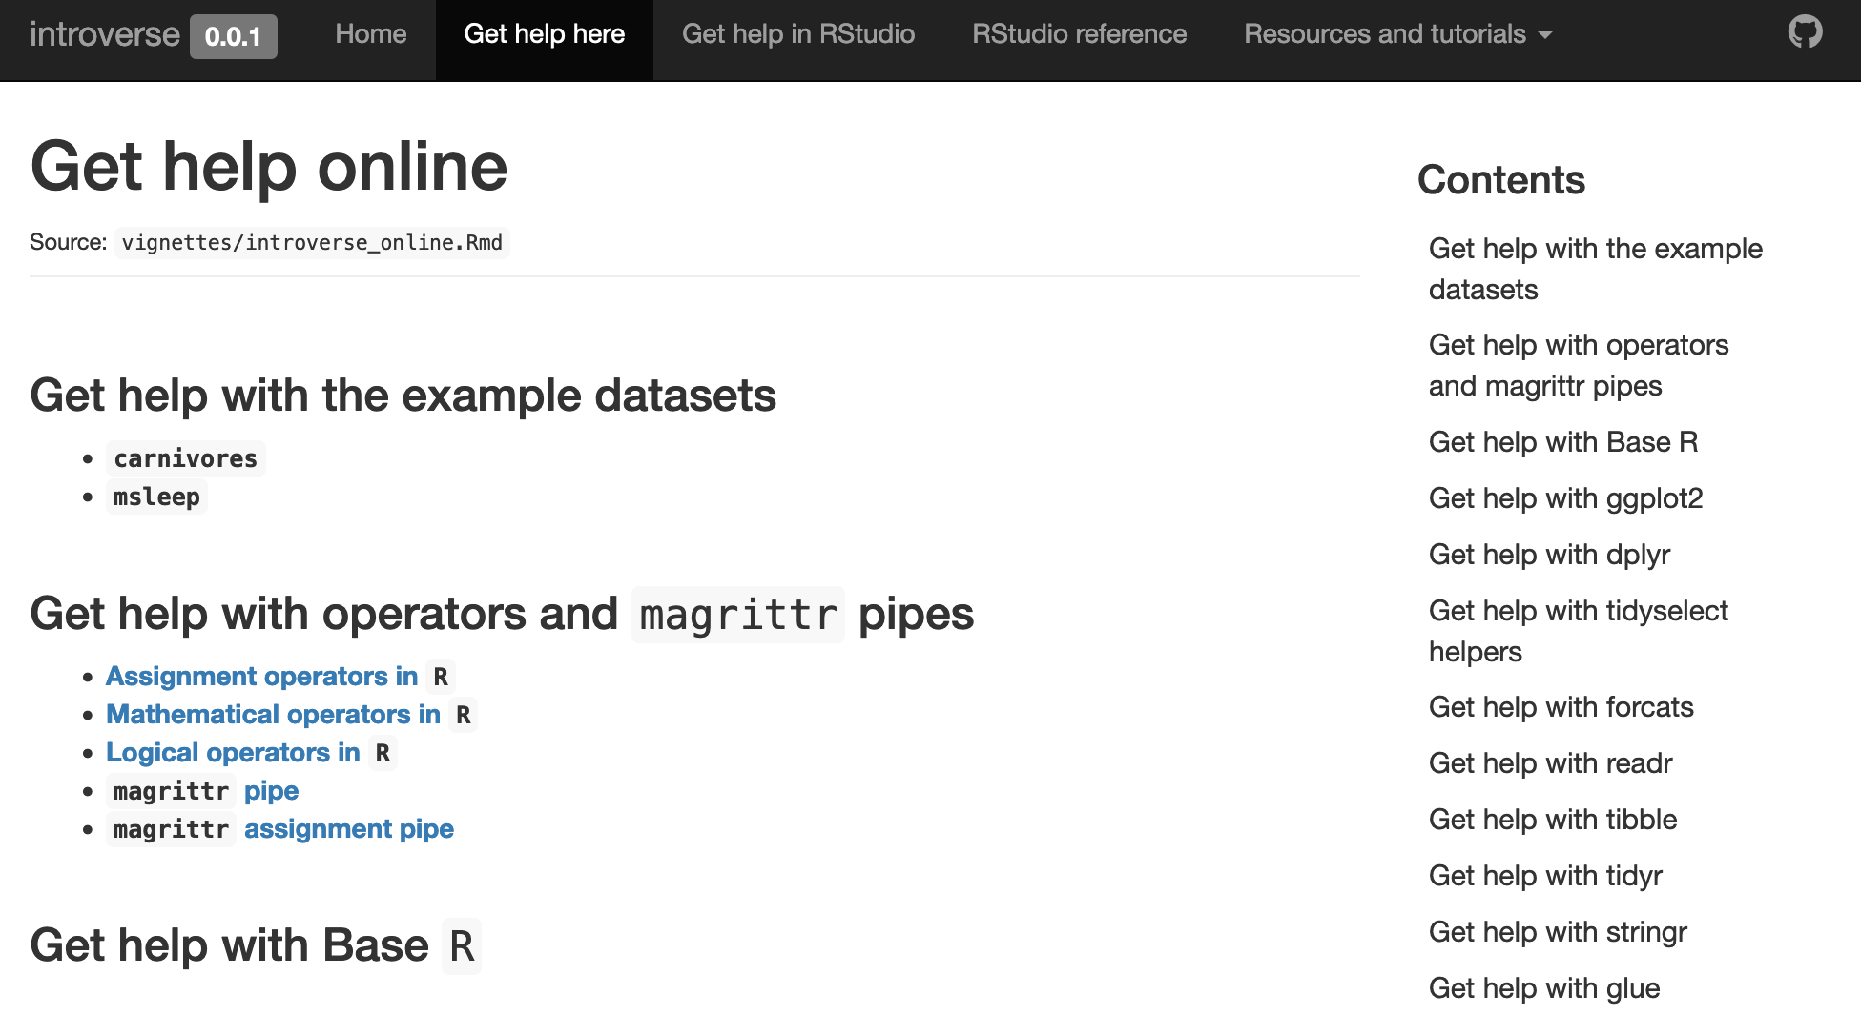
introverse package
https://sjspielman.github.io/introverse/articles/introverse_online.html

Slide 52
Additional Resources:
R packages specifically for linguistics data
quanteda: quantitative analysis of textual data (corpus management, tokenization, stemming, text analysis)
tm: text mining,; create and manipulate text documents, preprocessing, clustering , topic modeling.
stringr: strings and regular expressions. Good for pattern matching, string manipulation, and text cleaning
udpipe: Parse raw text; enables part-of-speech tagging, dependency parsing, and morphological analysis of text in multiple languages.
koRpus: quantitative text analysis (specifically for German. Handles tokenization, stemming, readability analysis, and other linguistic measures.
phonR: phonological analysis: phoneme transcription, syllabification, phonetic feature analysis, and phonological rule application.
lme4: Fitting linear mixed-effects models. For analyzing data with hierarchical or nested structures (e.g., experimentsal or language acquisition studies)
text2vec: text vectorization and feature extraction. Convert textual data into numerical representations, such as bag-of-words, TF-IDF, and word embeddings
WordNetR: Accessing and working with WordNet, a lexical database that provides semantic relationships between words. I
tm.plugin.webmining: Extention of ‘tm’ package. Scrape and process text from websites

